Slide 1
PUV MODERNIZATION
30 JUNE 2023

Slide 2
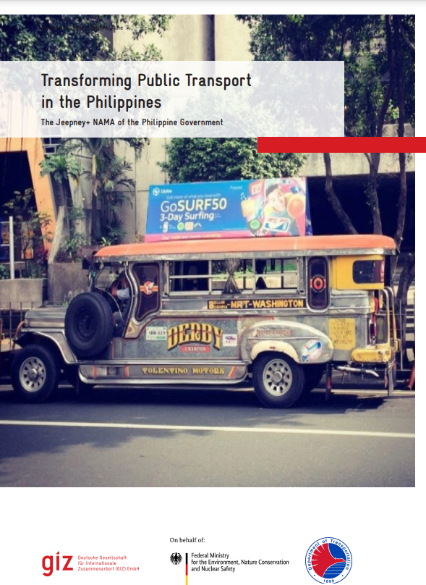
BASIS AND PRINCIPLES
C
A
R
E
S
Comfort
Accessibility
Reliability
Environmental Soundness
Safety
“The vehicle is fitted with comfortable seats where passengers are able to relax, rest, and productive during the journey.”
“Public transport must be available in every community, with accessibility for all segments of society, including senior citizens and persons with disabilities."
“Public transport must be predictable in terms of travel time, waiting, and schedule.”
“All vehicles and services shall comply with national standards and international vehicle safety conventions.”
“Public transport vehicles with combustion engines must have low emissions…
Other preferred public transport vehicles are those using electric drivers and/or running on alternative fuels…”

Slide 3
COMPONENTS
REGULATORY
REFORM
FINANCING
LOCAL PUBLIC
TRANSPORT ROUTE PLAN
VEHICLE
USEFUL LIFE
ROUTE
RATIONALIZATION
PUVMP
INITIAL
IMPLEMENTATION
COMPONENTS
FLEET
MODERNIZATION
STAKEHOLDER
SUPPORT
INDUSTRY CONSOLIDATION
COMMUNICATION

Slide 4
Organizational Linkages
Civil society organizations
Private stakeholders
DENR
DOST
DILG
CDA
DOTr Planning
LTO
DOTr Road
OTC
LTFRB
TESDA
DOLE
DTI
SEC
Legislators
Academe
Financing Institutions

Slide 5
REGULATORY REFORM
Constitution of an Interim Program Steering Committee (PSC) and Technical Working Group (TWG)
Call for Position Papers from various stakeholders on the comments and suggestions for PUVMP Implementation
Conduct of and attendance to stakeholder consultations, meetings

Slide 6
Garage
LTFRB MC 2017-29
Abandoned CPC
LTFRB MC 2018-11
Safety Officer
LTFRB MC 2017-28
Drop. and Sub.
LTFRB MC 2018-12
LTFRB MC 2019-66
LTFRB MC 2021-21, LTO-LTFRB JMC No. 1, S. 2021,
LTFRB MC 2022-33
IRIP
LTFRB MC 2017-29
DOTr DO 2022-5, LTFRB MC No. 2022-63, 2022-76, 2022-81
Equity Subsidy
DOTr DO 2018-16
DOTr DO 2020-6, LTFRB MC 2020-85
LTFRB MC 2023-18
Terminals
LTFRB MC 2017-30
RAA 11311 and IRR
LTFRB MC 2020-21
LTFRB MC 2022-51,
LTFRB MC 2022-54
Max. Distance
LTFRB MC 2017-31
Fare
LTFRB MC 2019-035, 2019-061
CPC Validity
LTFRB MC 2020-44
LPTRP
DILG-DOTr JMC 1, S. 2017
DILG MC 2018-60
DILG MC 2021-139
Initial Imp.
LTFRB MC 2018-006, 2018-013, 2018-14
Various MCs opening routes under Initial Implementation
CPC Conso.
LTFRB MC 2018-8, 2018-10
LTFRB MC 2021-021, 2021-77, LTFRB BR 35, S. 2021
LTFRB MC 2022-33, 2022-59, 2022-71
LTFRB MC 2019-13, 2019-66
LTFRB MC 2020-27, 2020-84
LTFRB MC 2023-13, 2023-17
Operator Selection
LTFRB MC 2018-9
LTFRB MC 2019-13
LTFRB MC 2021-21
LTFRB MC 2022-33
Scrappage
DOTr DO 2020-021
LTO-LTFRB JMC No. 1, S. 2021,
LTFRB MC 2021-62
PUV Specs
LTFRB MC 2021-2, 2021-15, LTFRB BR 68, S. 2021
LTFRB MC 2022-27, 2022-47, DOTr DO 2022-19
2017
2018
2019
2020
2021
2022
2023

Slide 7
LOCAL PUBLIC TRANSPORT ROUTE PLANNING
1,035 LGUs
PROVINCE
60.53%
PROVINCE
85.53%
With submitted Local Public Transport Route Plan (some of which are already approved)
65 out of 76 submitted (12 are with NOC)
90.91%
HUC and ICC
77.27%
HUC and ICC
20 out of 22 submitted (7 are with NOC)
147 LGUs
CITY
65.71%
CITY
81.90%
With approved Local Public Transport Route Plan (issued with Notice of Compliance or Special Notice of Compliance)
86 out of 105 submitted (20 are with NOC)
37.54%
MUNICIPALITY
62.97%
MUNICIPALITY
864 out of 1,372 submitted (108 are with NOC)
*As of 30 June 2023

Slide 8
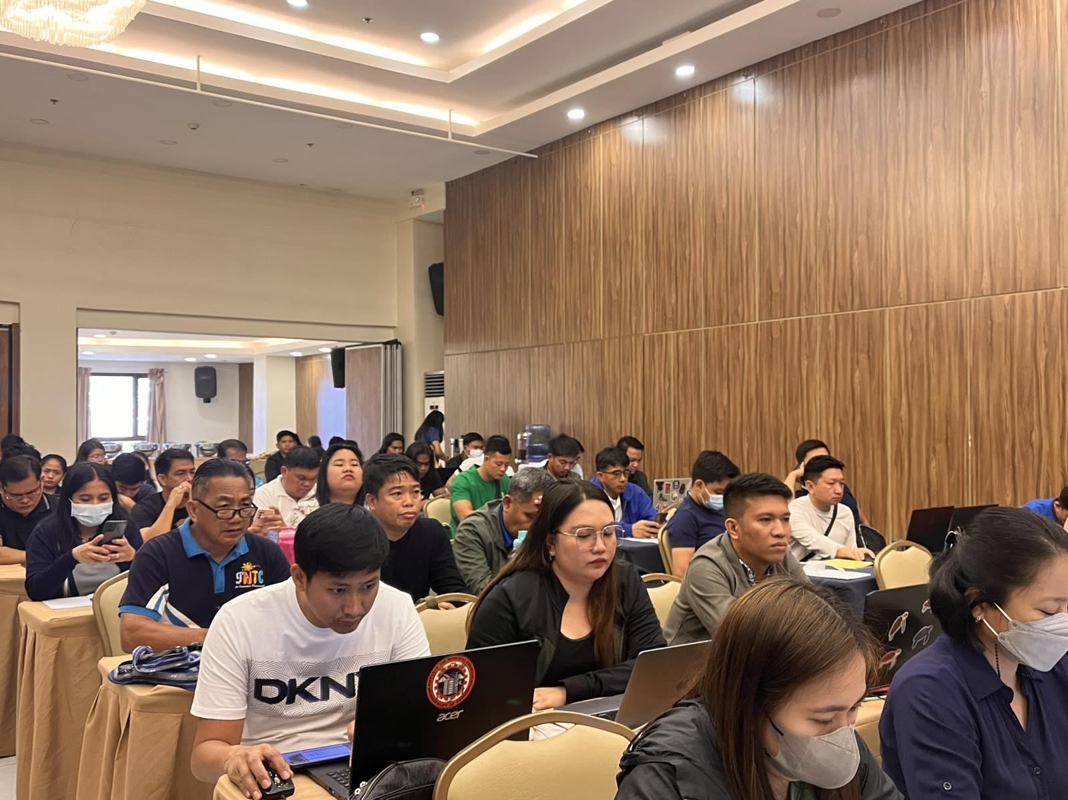
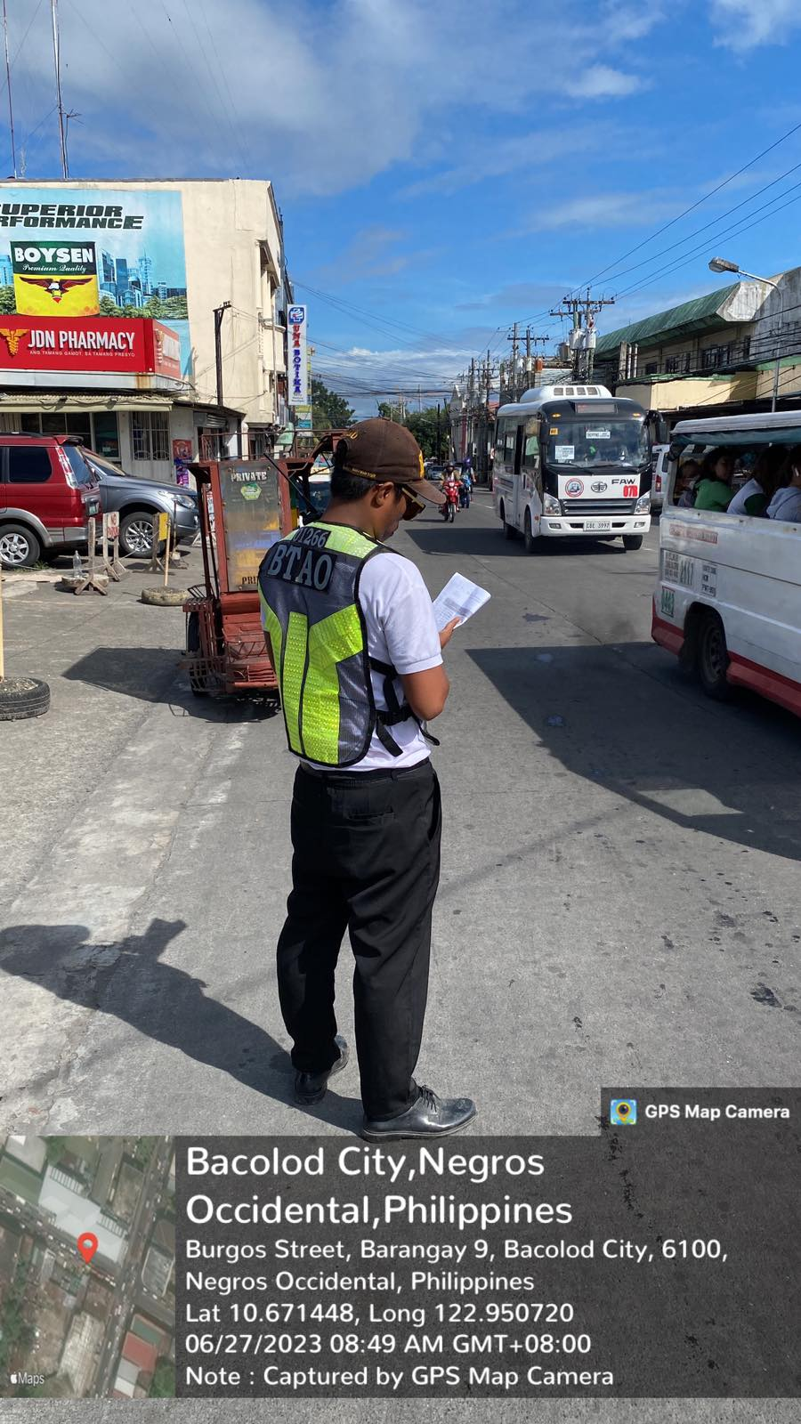
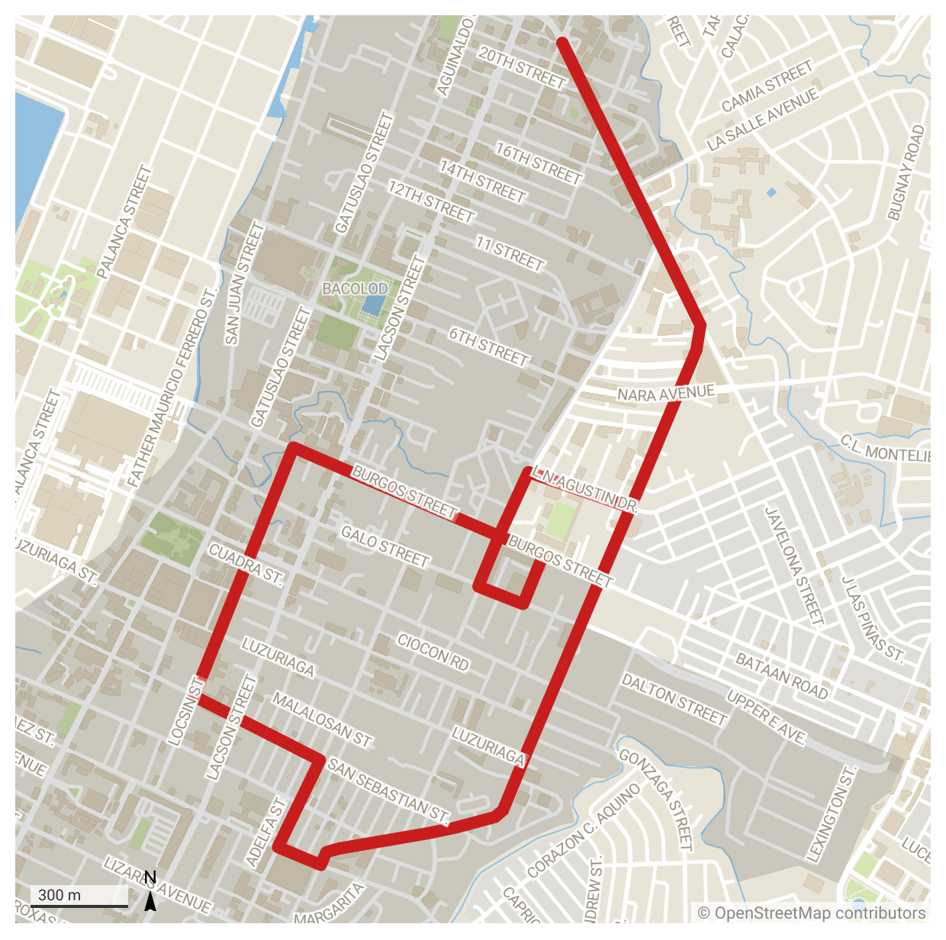
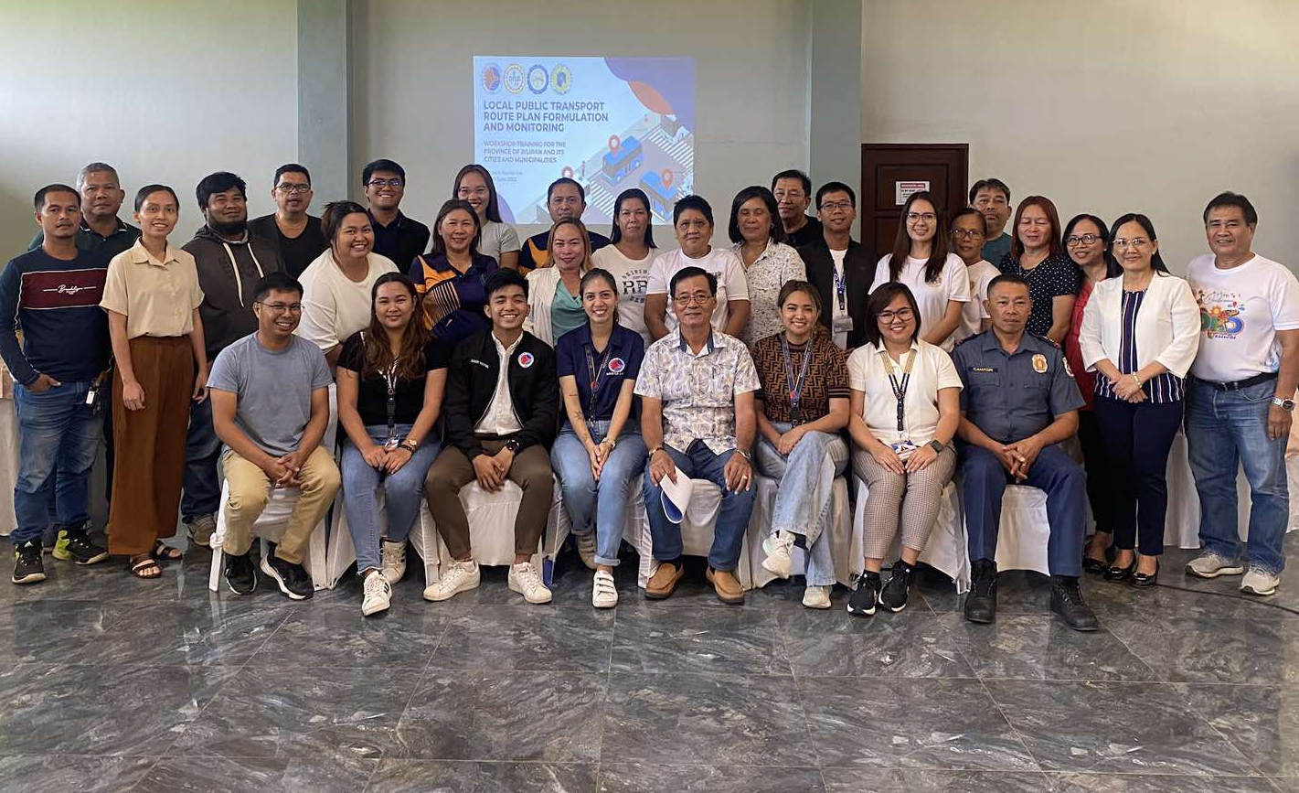
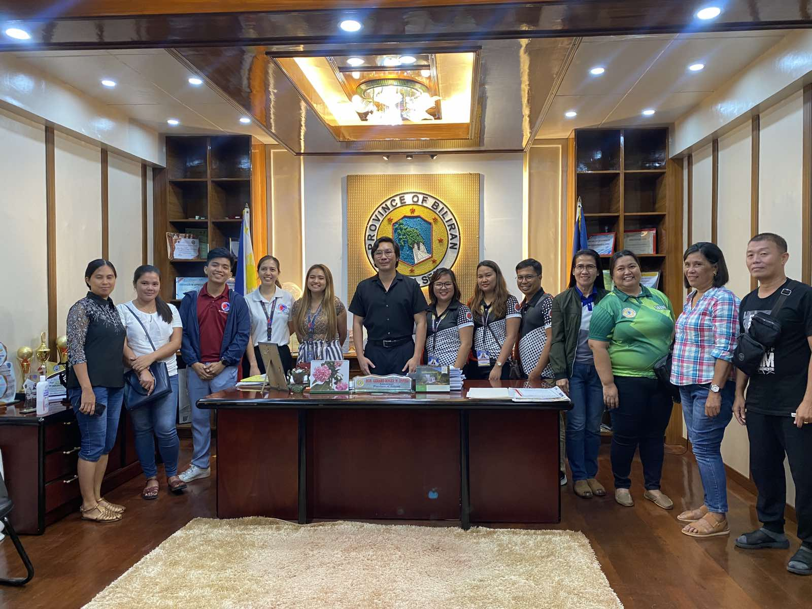
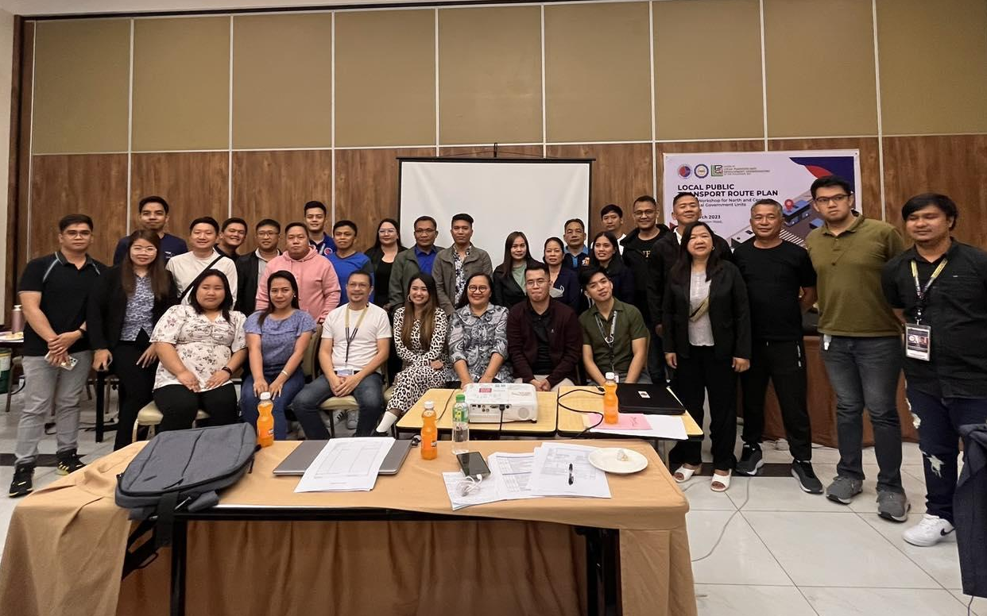
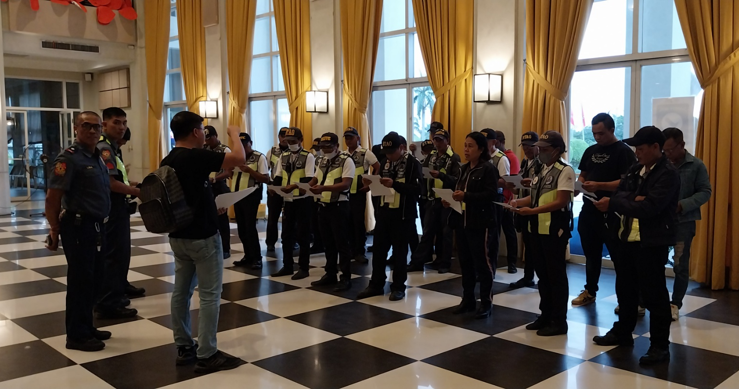
LOCAL PUBLIC TRANSPORT ROUTE PLANNING
LPTRP Workshop with North Luzon LGUs in partnership with LLPDCPI
(21-23 March 2023)
LPTRP Workshop with Biliran LGUs in partnership with Province of Biliran (06-10 June 2023)
LPTRP Simulation Exercise of Bacolod City LPTRP routes in partnership with SafeTravel PH
(24-28 June 2023)

Slide 9
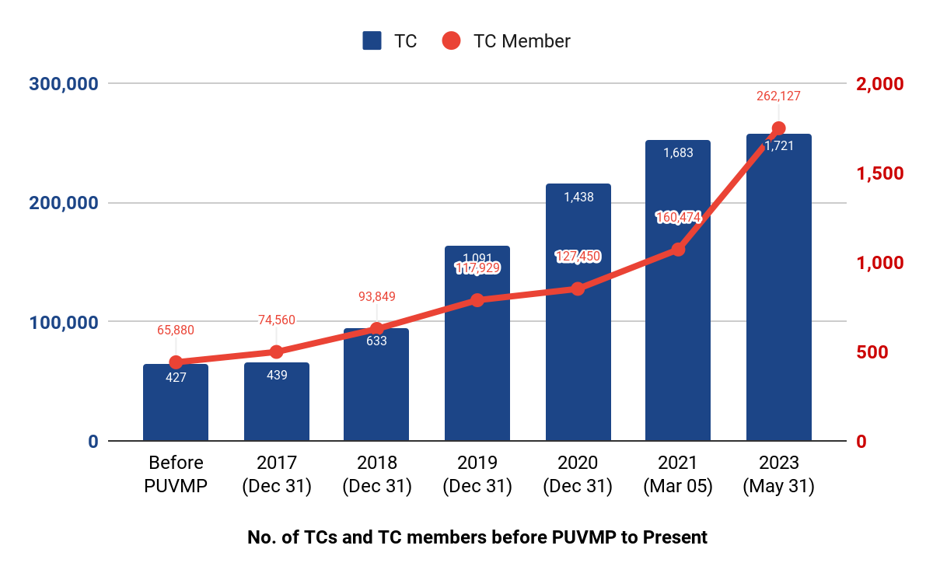
INDUSTRY CONSOLIDATION
ACCREDITED TRANSPORT COOPERATIVES AND MEMBERS
(as of May 2023)
262,127
1,721
Notes:
Logos for those w existing contractors

Slide 10
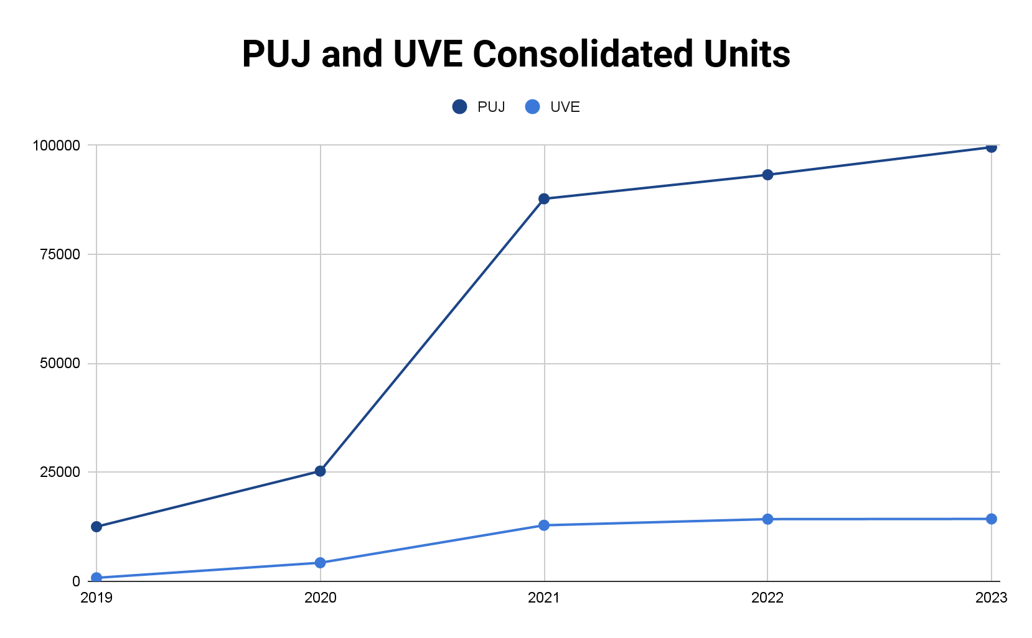
INDUSTRY CONSOLIDATION
PUJ AND UVE UNITS UNDER CONSOLIDATED CPCS
(as of May 2023)
93,243
98,801
87,737
31 Dec 2023
As per LTFRB MC 2023-017 operators have until end of the year to file for Applications for Consolidation of CPCs, for routes with no existing consolidated juridical entity yet.
25,261
14,247
14,289
12,508
12,836
4,237
780
Notes:
Logos for those w existing contractors

Slide 11
FLEET MODERNIZATION
CLASS 1
AVC: 11
Features: Side Facing Seats
CLASS 2
AVC: 22
Features: Side Facing Seats; With Provision for Standing
CLASS 3
AVC: 22
Features: Front-facing seats; for long drive
PNS 2131:2018
(LTFRB MC 2021-002)
PNS 2126:2017
(LTFRB MC 2021-002)
PNS 2126:2017
(LTFRB MC 2021-002)
CLASS 4
AVC: 22
Features: Front-facing seats;
With luggage/compartment
MINI BUS
AVC: 35
Features: With Provisions for Standing; With compartment
BUS
AVC: 50
Features: With Provisions for Standing; With compartment
PNS 2157:2021
(LTFRB MC 2022-027)
PNS 2160:2021
(LTFRB MC 2022-047)
PNS 2165:2022

Slide 12
FLEET MODERNIZATION
112 Models
57 Models
Issued with Certificate of Compliance (ongoing confirmation of active PUV Models with MAIDROEs)
Models manufactured/ assembled locally (ongoing validation of DTI-CARS PMO)
48 MAIDROES
22 MAIDROES
Manufacturers/assemblers
of the 112 models
Manufacturers/assemblers
of the 57models
Notes:
Logos for those w existing contractors

Slide 13
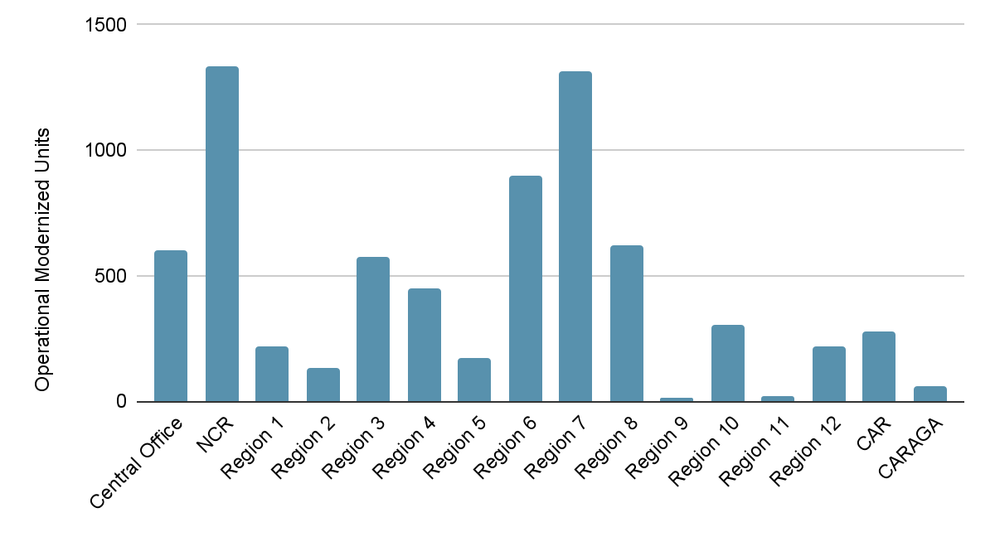
FLEET MODERNIZATION
OPERATIONAL MODERN CLASS 1,2,3 PUV UNITS
(as of May 2023)
7,228 Units
Modern Class 1, 2, and 3 PUV units operational nationwide
*As of 31 May 2023
Notes:
Logos for those w existing contractors

Slide 14
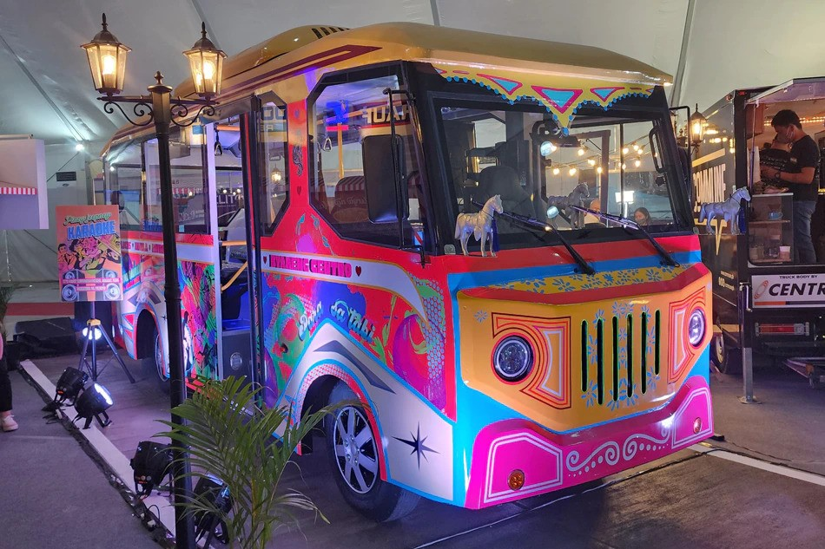
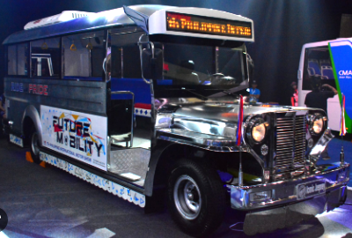
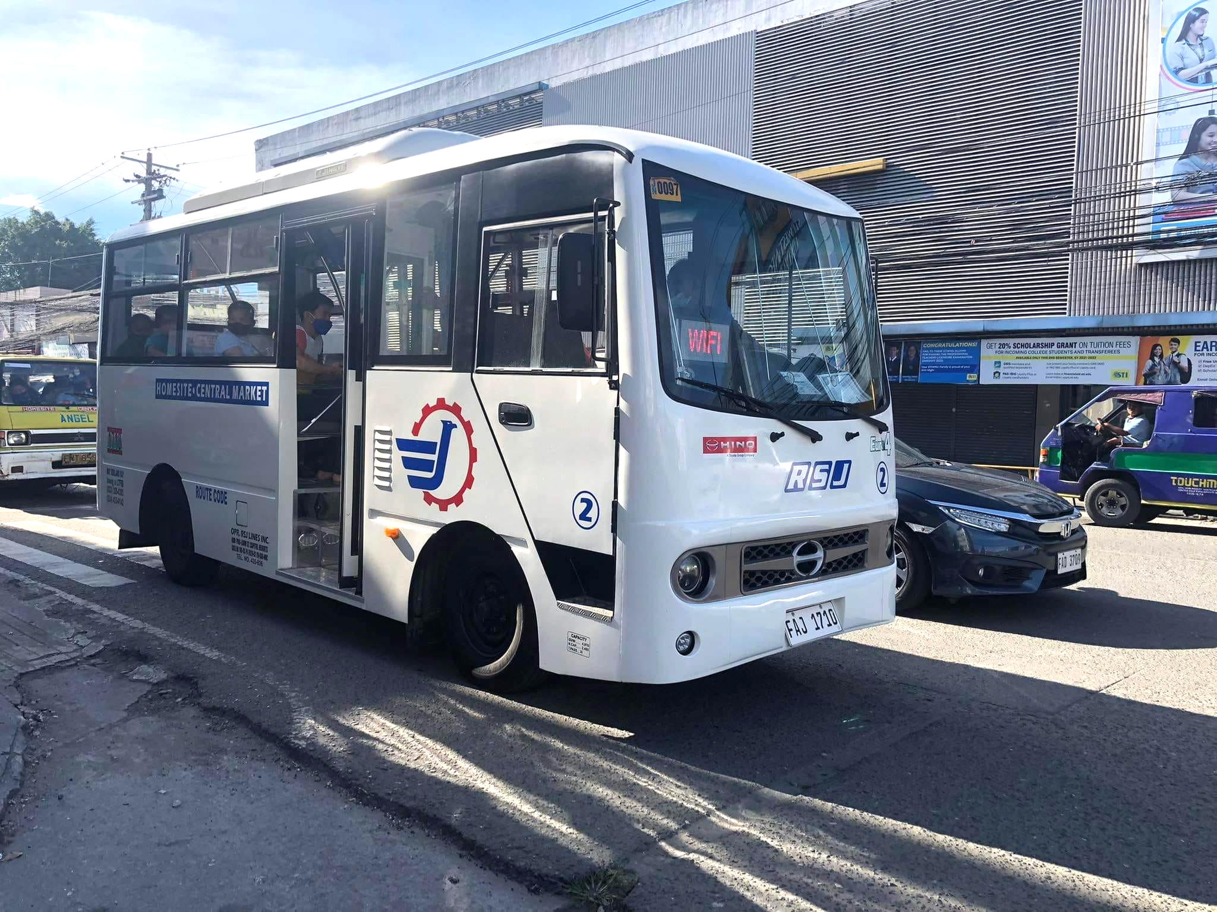
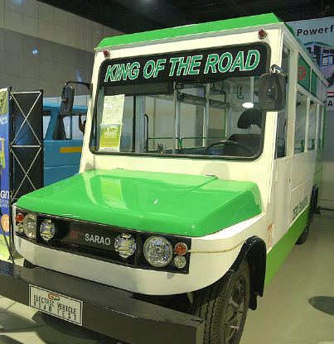
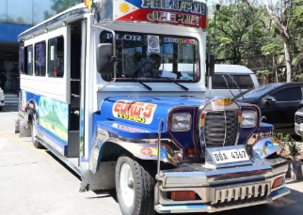
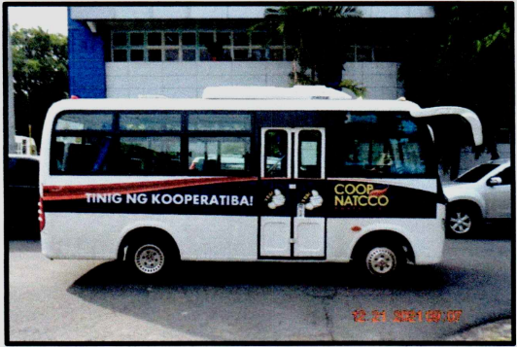
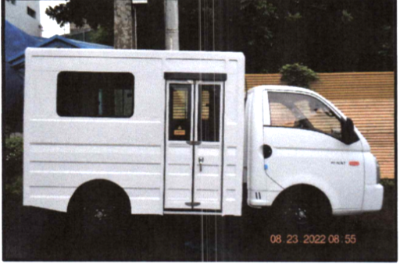
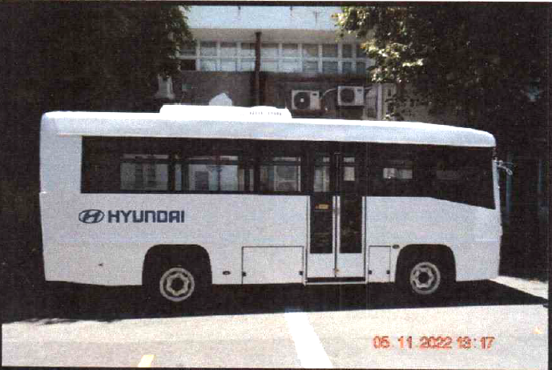
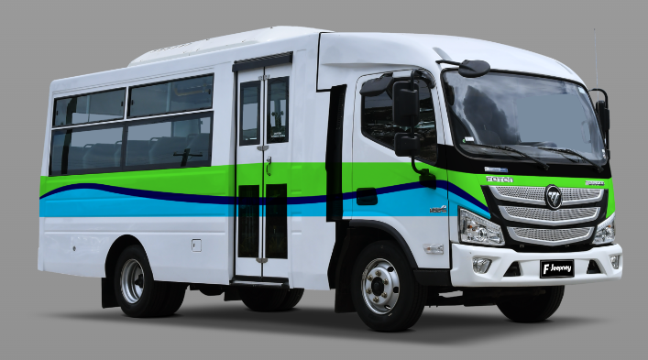
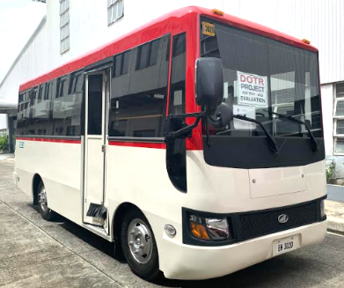
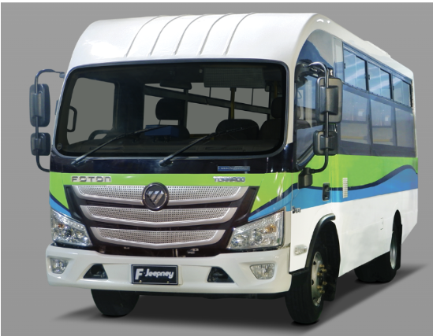
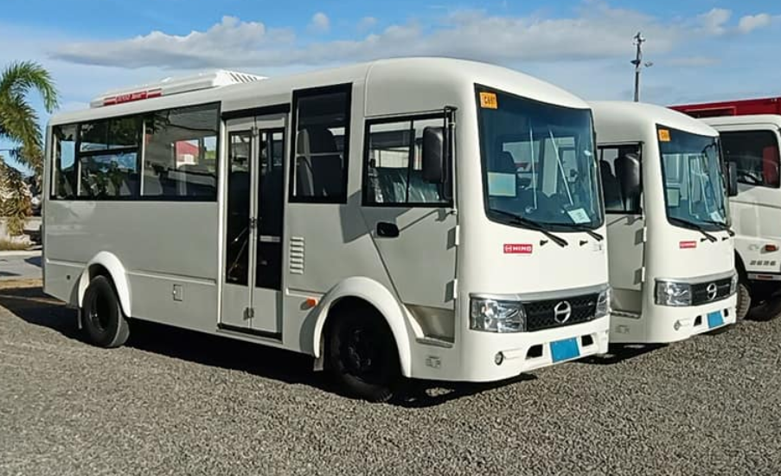
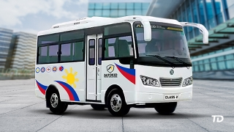
FLEET MODERNIZATION
Notes:
Logos for those w existing contractors

Slide 15
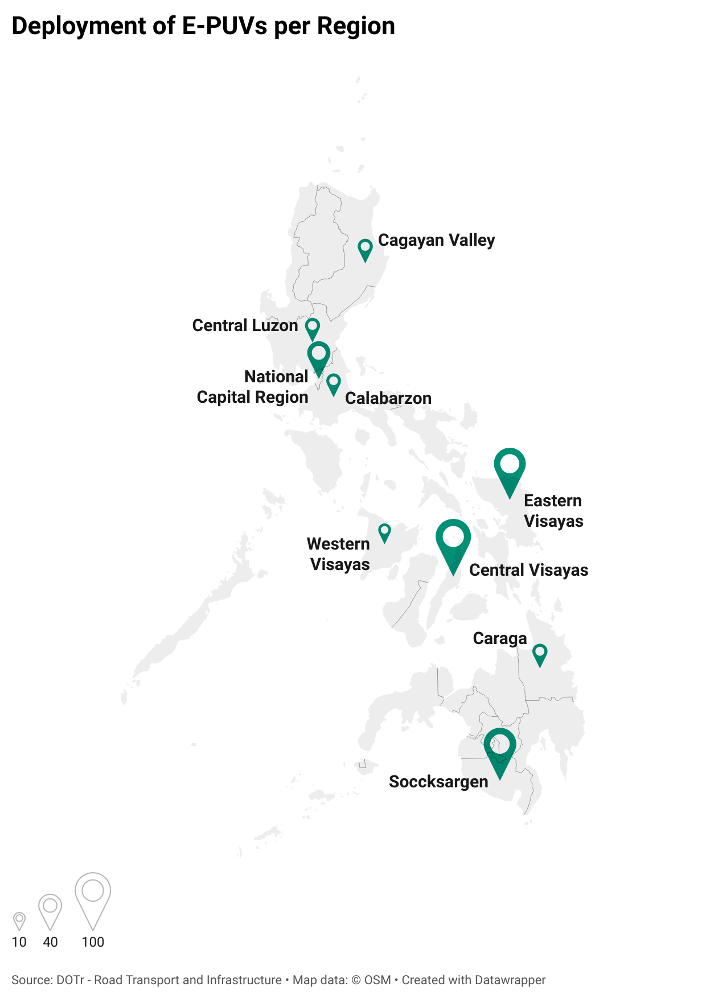
IMPLEMENTATION OF EVIDA
6 models
27 routes
Electric PUV models compliant to PNS and issued with COC
with operational e-PUVs nationwide
375 e-PUVs
5 MAIDROES
With electric PUV models compliant to PNS and issued with COC
operational nationwide
DEPLOYMENT OF E-PUVs PER REGION
*As of 31 May 2023
https://datawrapper.dwcdn.net/35ZL0/4/
Notes:
Logos for those w existing contractors

Slide 16
FINANCING
Private Financing Institutions
Php 15.6 B
Php 133.3M
Loan Approvals for 7,128 PUV units
Equity subsidy released for 313 PUV units
LTFRB MC No. 2023-018 was issued providing Guidelines on the Issuance of Alternative Certificate
Php 729 M
Php 63.8 M
Equity subsidy released for 4,659 PUV units
Equity subsidy in reserved application for 178 units
7,128 units
Notes:
Logos for those w existing contractors

Slide 17
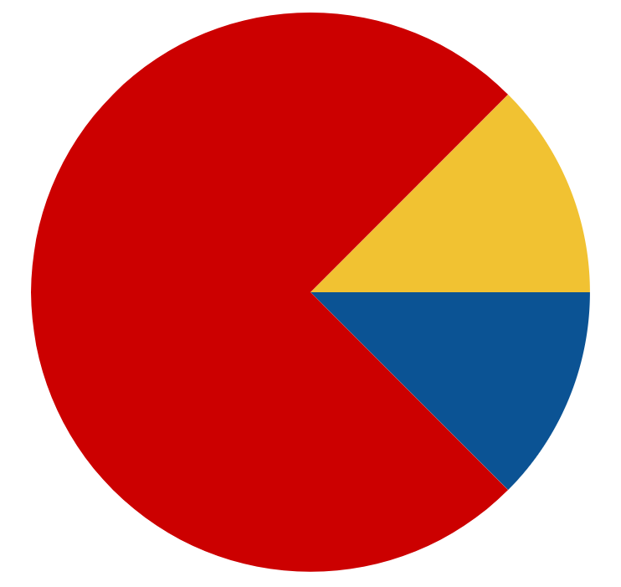
VEHICLE USEFUL LIFE
63 facilities
Pre-qualified with the standards set
(shortlist provided in LTFRB MC 2021-062)
12 facilities
nearing completion
of accreditation process
2 facilities
expressed intent
(on process)
36 facilities
Inspected by the DOTr, LTFRB, and LTO nationwide
2 facilities
set to be accredited
this Q3 2023
16 facilities
Expressed intent
to join the Program
Notes:
Logos for those w existing contractors

Slide 18
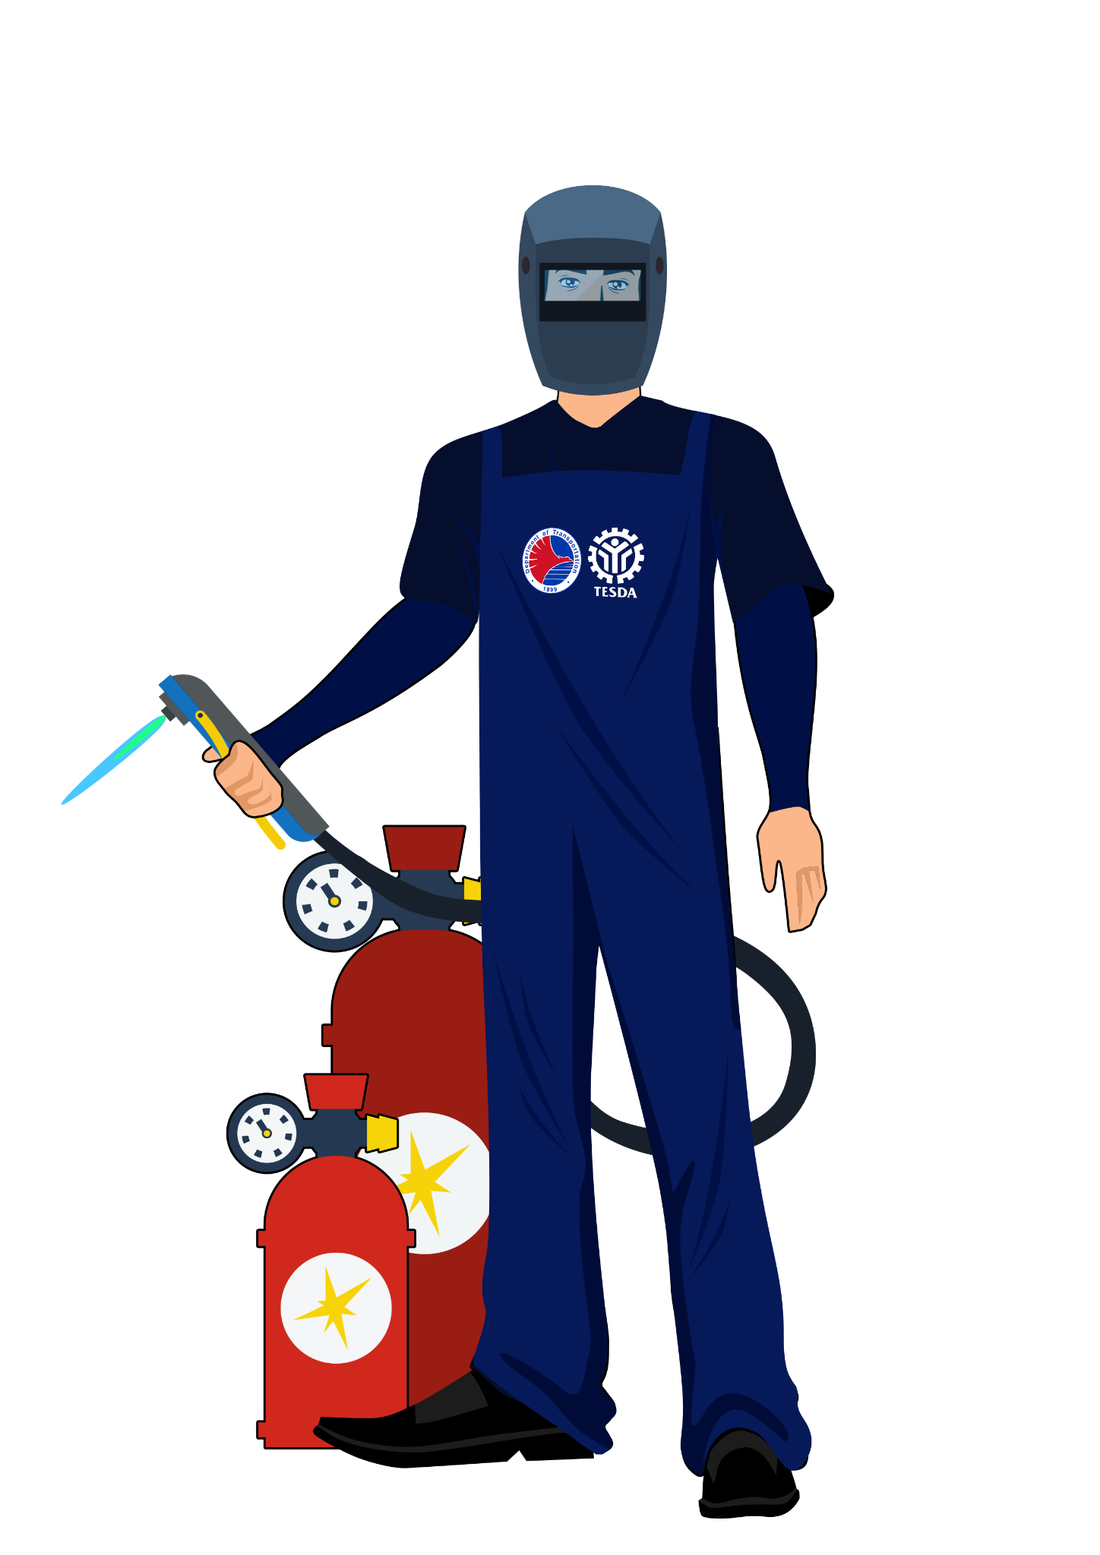
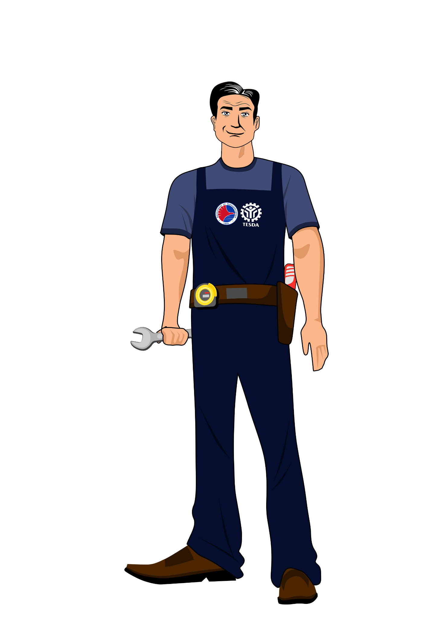
SOCIAL SUPPORT COMPONENT
97.83%
97.68%
Approved slots vs. enrolled
(GAA FY 2018)
Approved slots vs. enrolled
(GAA FY 2021)
PHYSICAL ACCOMPLISHMENTS
Fund Source | 2018 GAA (PhP 350M) | 2021 GAA (PhP 100M)
Approved slots | 20,853 | 3,154
Graduates | 19,265 | 3,043
Assessed graduates | 16,404 | 2,706
Certified graduates | 15,058 | 2,468
Employed graduates | 3,479 | 729
TSUPER ISKOLAR PROGRAM
Notes:
Notes:
TSUPER ISKOLAR PROGRAM
TESDA is still complying with the requirement of at least 75% liquidation (before the signing of a new MOA, in this case, the funding under 2022 GAA);
Draft MOA was transmitted to TESDA for review on 07 March 2023; no feedback yet from TESDA as of last follow-up on 29 March 2023;
DOTr sent a memo to LTFRB and OTC following up the submission of beneficiaries for the 2022 GAA implementation last 30 March 2023 (one of the several follow ups)
ENTSUPERNEUR PROGRAM
DOLE requested for the funding under the 2021 GAA_____

Slide 19
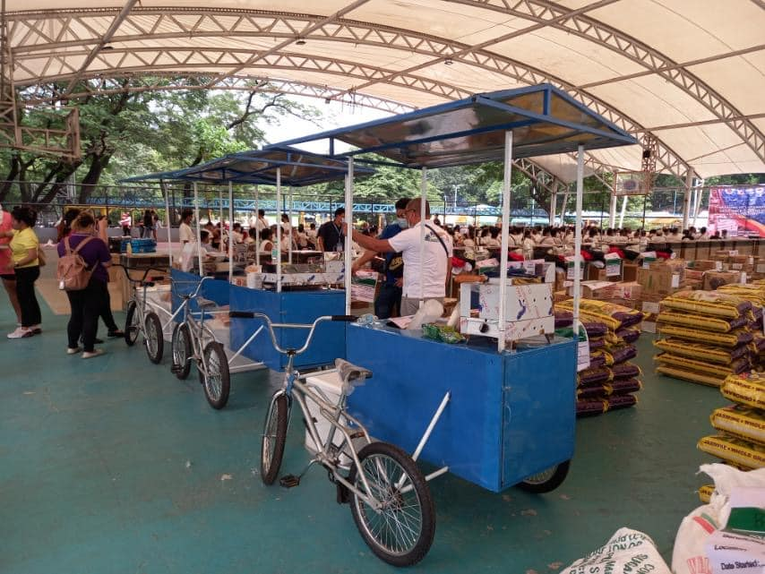
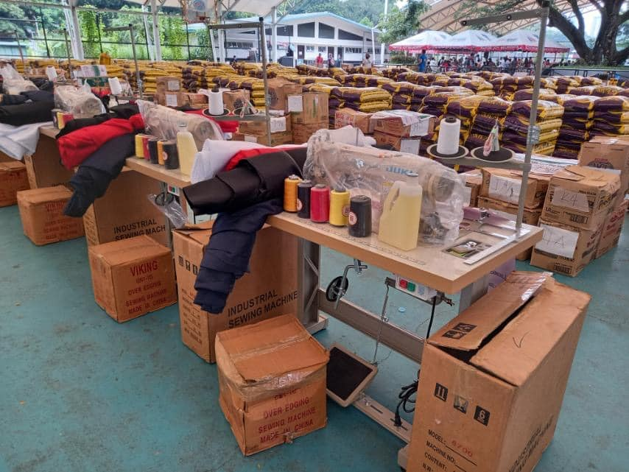
SOCIAL SUPPORT COMPONENT
ENTSUPERNEUR PROGRAM
PHYSICAL ACCOMPLISHMENT
Fund Source | 2021 GAA (PhP 200M) | 2022 GAA (PhP 450M)
Approved slots | 6,333 | 14,250
Endorsed beneficiaries | 6,333 (ongoing implementation. DOLE is also requesting from BTr the reutilization of the 2021 GAA funds to settle accounts payable) | 5,662 (for implementation)
Percentage of Accomplishment | 100% | 39.73%
Notes:
Notes:
TSUPER ISKOLAR PROGRAM
TESDA is still complying with the requirement of at least 75% liquidation (before the signing of a new MOA, in this case, the funding under 2022 GAA);
Draft MOA was transmitted to TESDA for review on 07 March 2023; no feedback yet from TESDA as of last follow-up on 29 March 2023;
DOTr sent a memo to LTFRB and OTC following up the submission of beneficiaries for the 2022 GAA implementation last 30 March 2023 (one of the several follow ups)
ENTSUPERNEUR PROGRAM
DOLE requested for the funding under the 2021 GAA_____

Slide 20
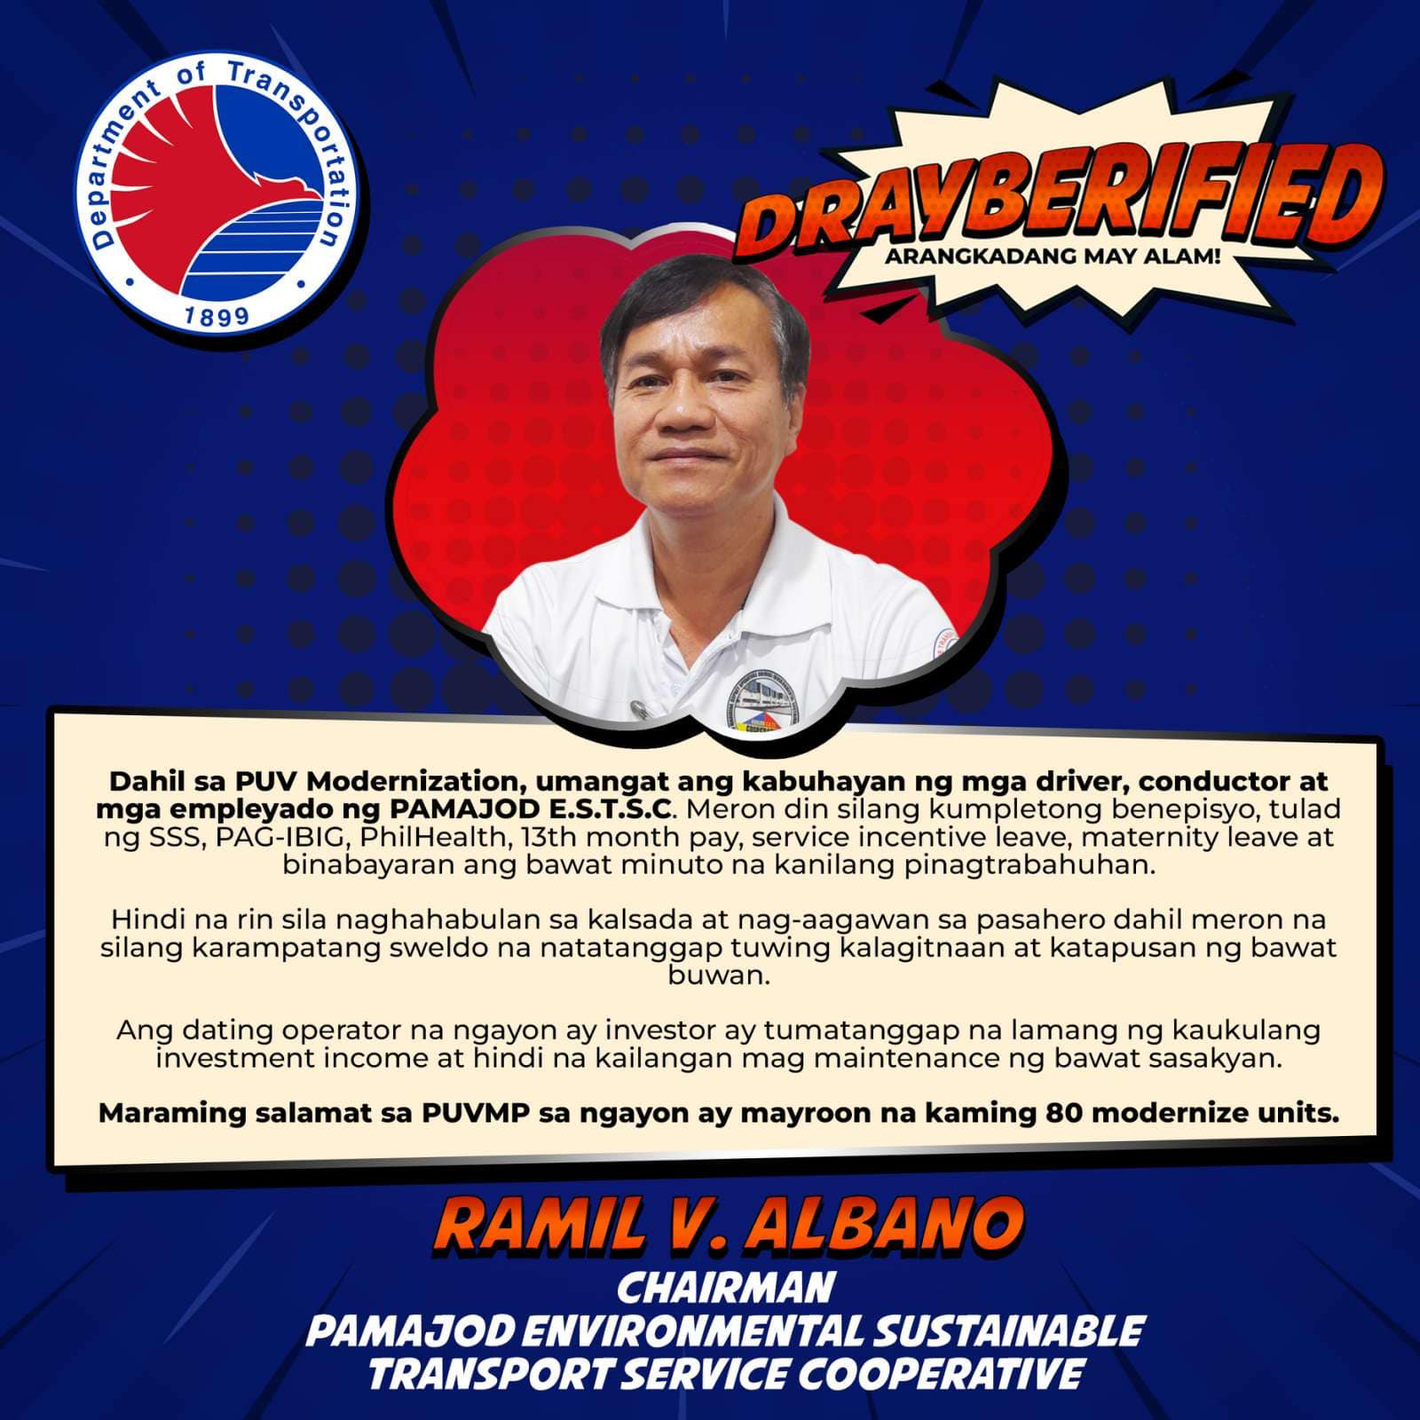
COMMUNICATIONS
Sama-Sama sa Arangkada Facebook Page
Notes:
Logos for those w existing contractors

Slide 21
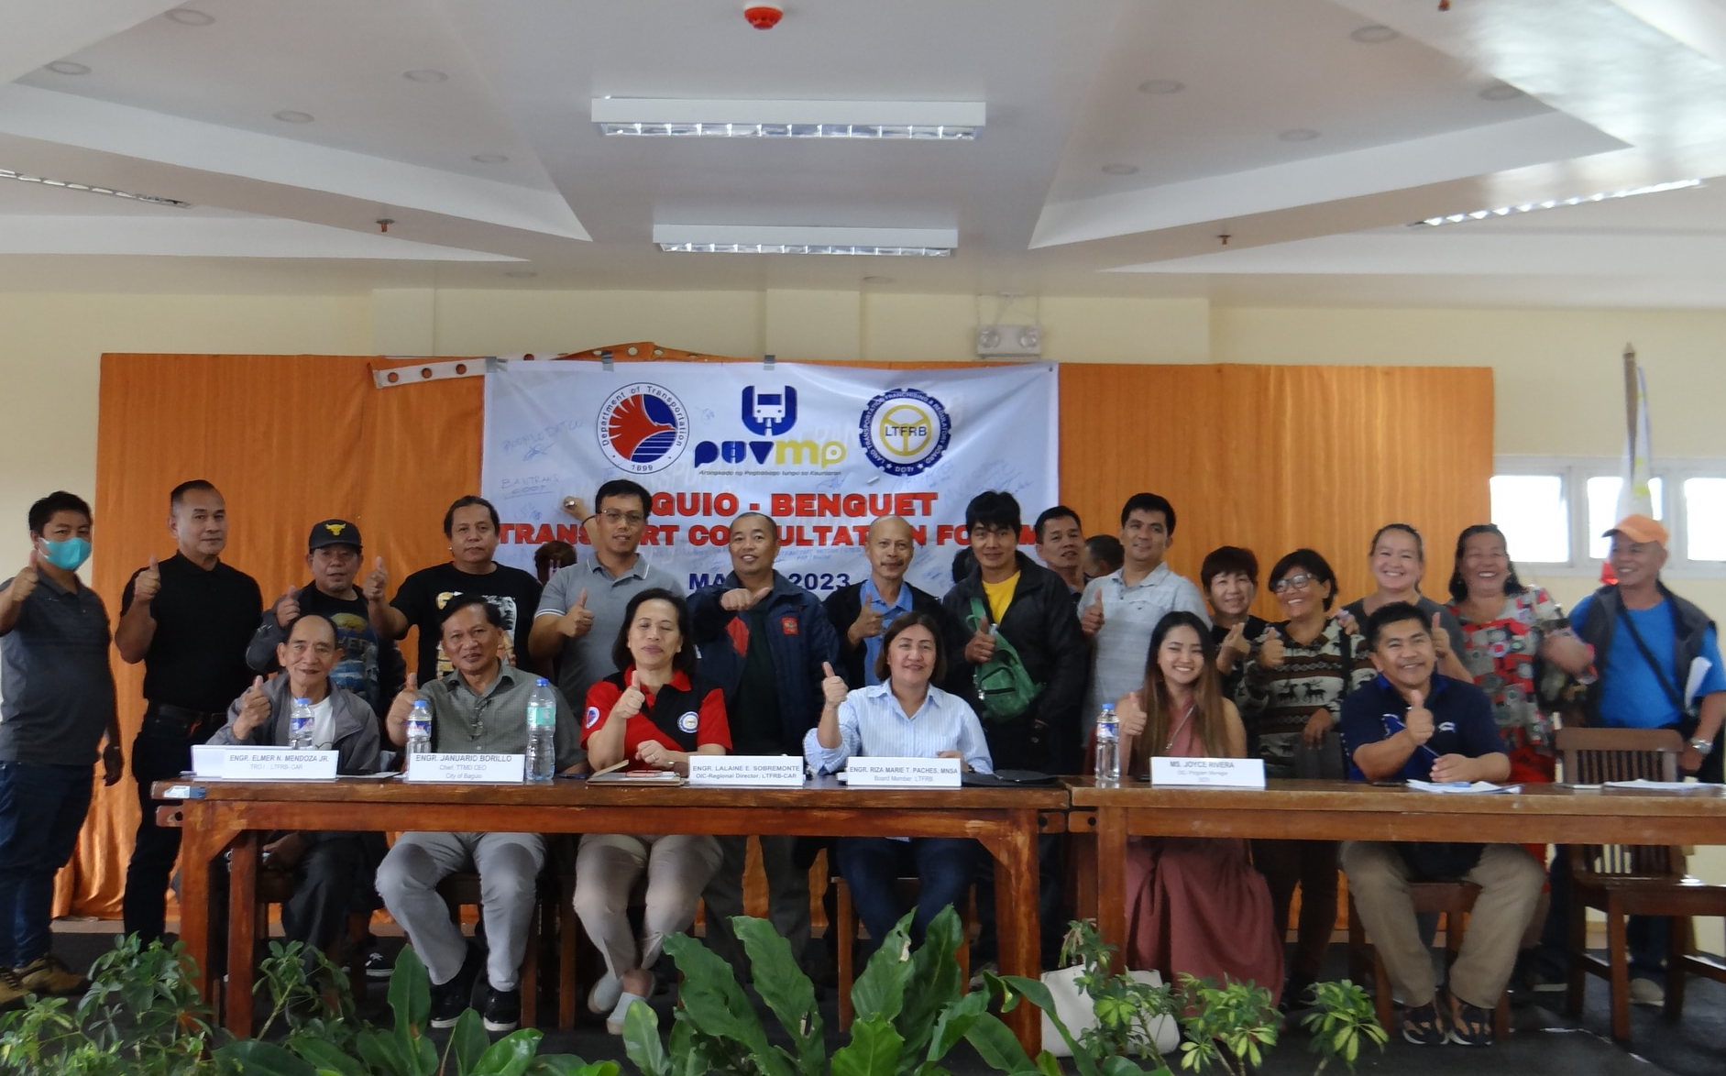
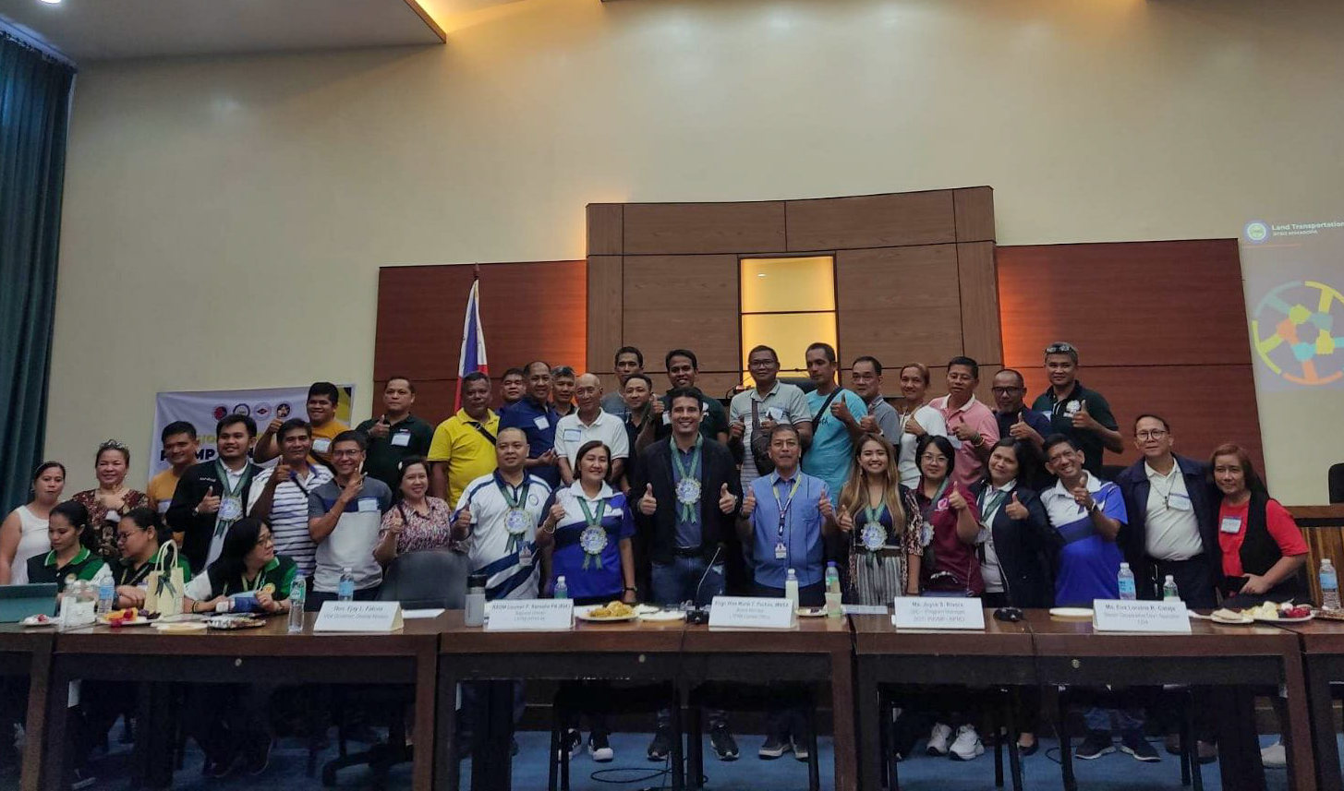
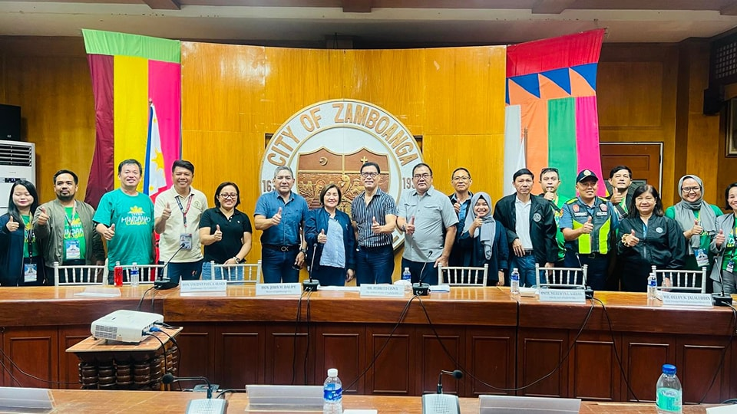
COMMUNICATIONS
CAR Consultations
Baguio City
05 May 2023
Region IV-B Consultations
Calapan City, Mindoro
21-22 June 2023
Region IX Consultations
Dipolog City, Zamboanga del Norte
29 June 2023
Notes:
Logos for those w existing contractors

Slide 22
WAYS FORWARD
Streamline process and requirements
Establish realistic targets
Establish feedback mechanism
Institutionalization of the Program
Notes:
Just transition provides the stakeholders not just an ample time to participate in the modernization but as well as the means and resources to do it.

Slide 23
FOR QUESTIONS AND CLARIFICATIONS
Joyce S. Rivera
OIC Program Manager
PUV Modernization Program
National Program Management Office
Department of Transportation
jsrivera.dotr@gmail.com
Notes:
Logos for those w existing contractors

Slide 24
DEPARTMENT OF TRANSPORTATION
ROAD TRANSPORT AND INFRASTRUCTURE
THANK YOU

