Slide 1
Engineering the LPG PUV Using an OEM Vehicle Platform
UP NCTS – DOST – DOE Project

Slide 2
Original Project Objectives
a) Use an OEM vehicle platform, light truck or pick up (cab and chassis), to develop a jeepney design of 18-20 passengers that conform to PNS 2111:2015 CLRV Dimensional Limits
b) Introduce weight reduction measures in the body design
c) Construction using OEM-approved manufacturing processes a prototype of this jeepney design
d) Road-test the prototype jeepney design

Slide 3
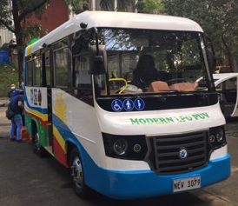
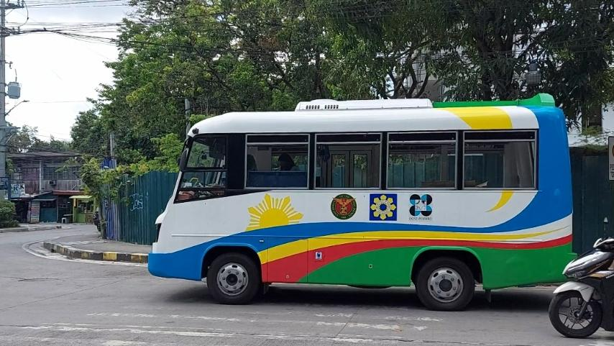
Project Objectives vs. Accomplishments
a) Use an OEM vehicle platform, light truck or pick up (cab and chassis), to develop a jeepney design of 18-20 passengers that conform to PNS 2111:2015 CLRV Dimensional Limits
Final prototype was constructed using an OEM vehicle platform with 18-passenger capacity conforming with PNS 2126:2017, PUV Class I (9-22 passengers, all seated); UNECE Category M2 Class B

Slide 4
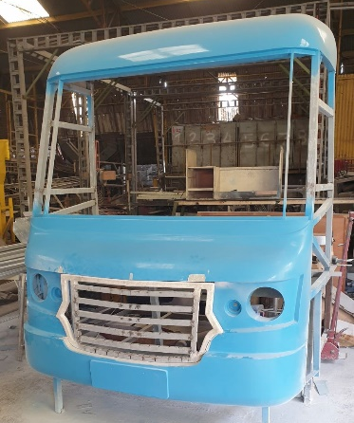
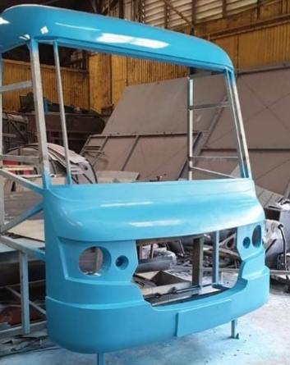
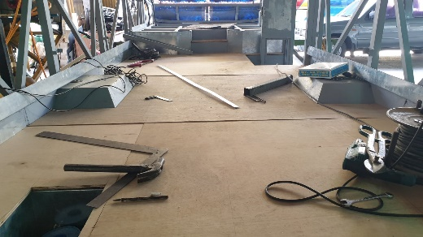
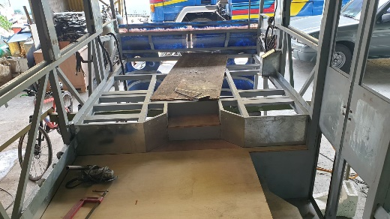
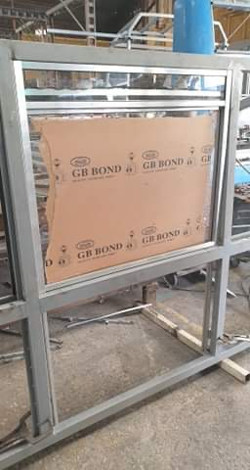
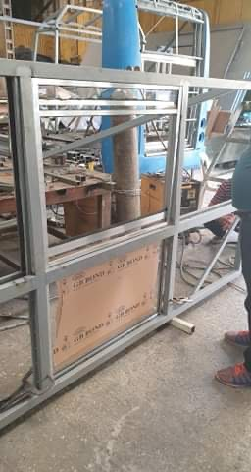
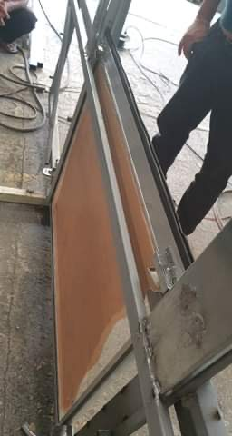
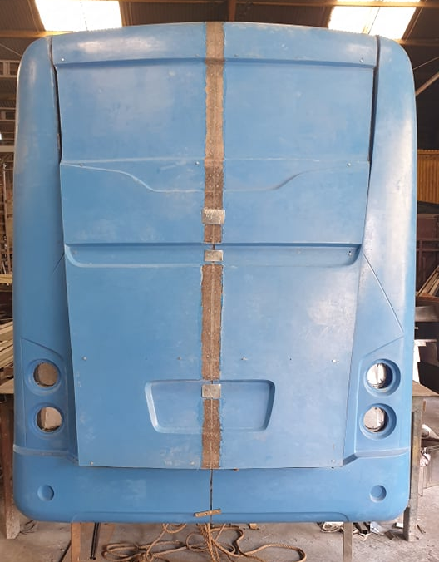
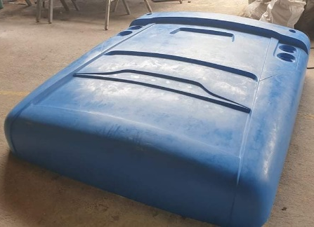
Project Objectives vs. Accomplishments
Introduce weight reduction measures in the body design
Final prototype was constructed with marine plywood and vinyl matting flooring, aluminum window frames, molded fiberglass front and rear body panels

Slide 5
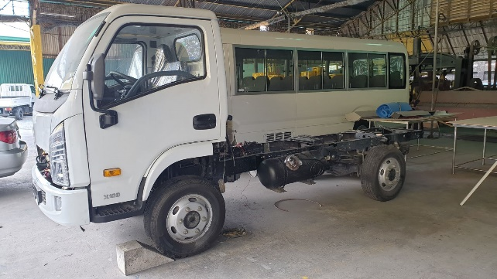
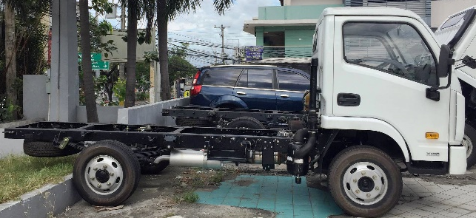
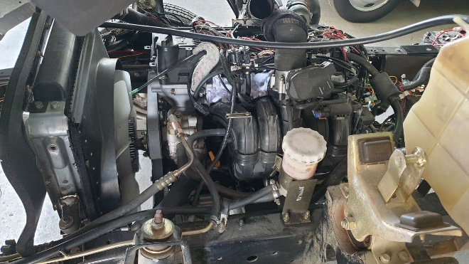
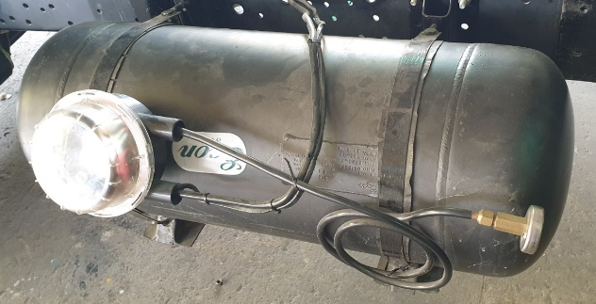
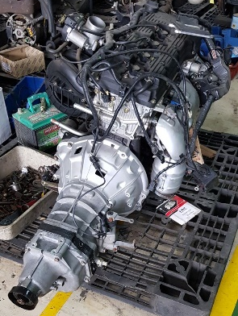
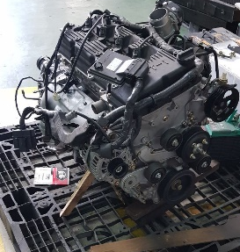
Project Objectives vs. Accomplishments
Construction using OEM-approved manufacturing processes a prototype of this jeepney design
Final prototype was constructed using a light truck cab and chassis platform and a 2.4-liter brand new gasoline engine retrofitted for LPG fuel
Naveco X101-28
Clean Fuel Tartarini LPG system
2TZ gasoline engine

Slide 6
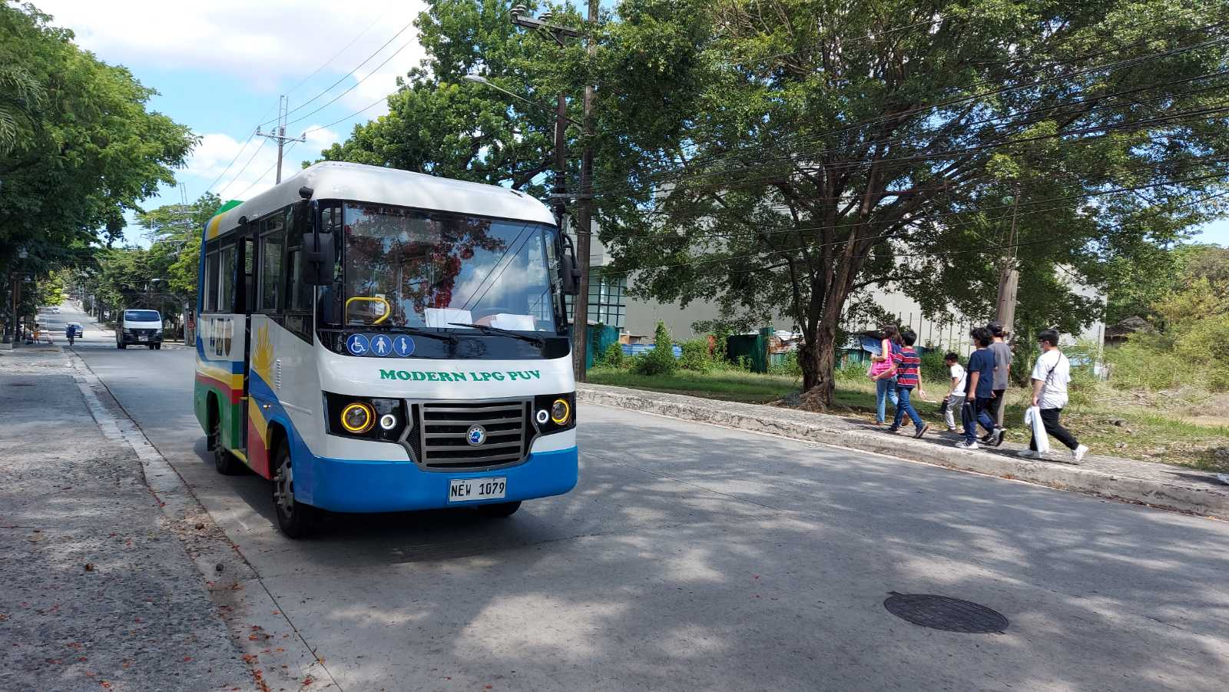
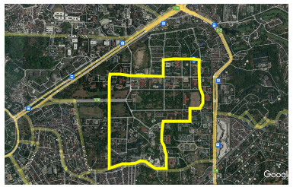
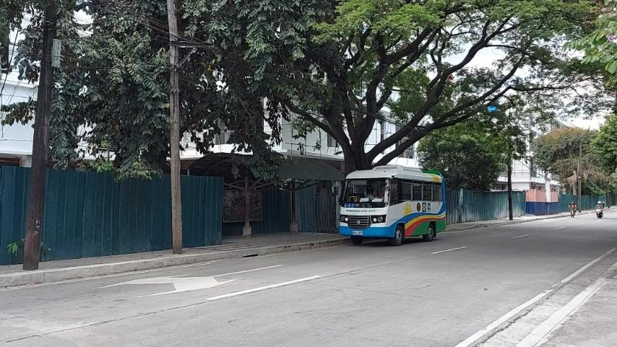
Project Objectives vs. Accomplishments
Road-test the prototype jeepney design
Final prototype was road tested along a selected UP-Ikot route.

Slide 7
Project Objectives vs. Accomplishments
d) Road-test the prototype jeepney design
UP-Ikot Road Test Results are shown below.
* Aircon duty cycle during tests is unknown
Re-tuning (2nd) was performed after the first (1st) tuning LPG test run
Fuel economy difference between LPG and Gasoline is within range of percent difference in Heating Value/liter

Slide 8
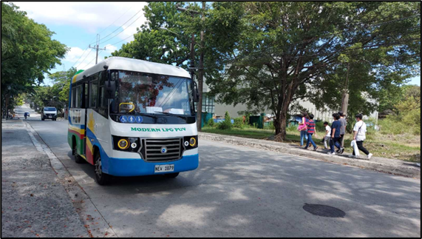
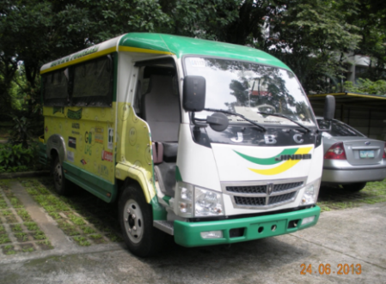
Project Objectives vs. Accomplishments
d) Road-test the prototype jeepney design
UP-Ikot Road Test Results are shown below.

Slide 9
PHASE 1 Route (SHORT roundtrip length of 13.25 km) Consists of urban driving segments (mostly 2-4 lanes per direction) characterized by stop-and-go conditions because of traffic signals and relatively shorter distances between stops
EASTBOUND Route (SM North to UP Vinzon’s Hall : 6.75 km)

Slide 10
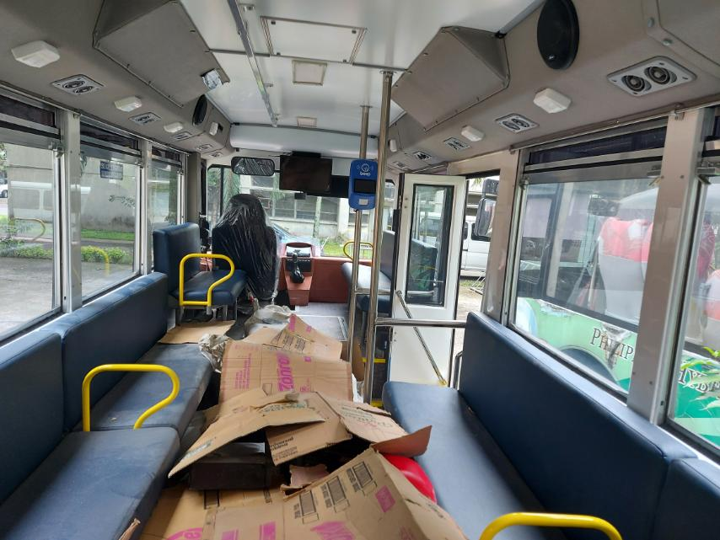
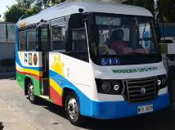
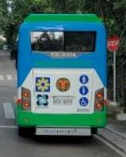
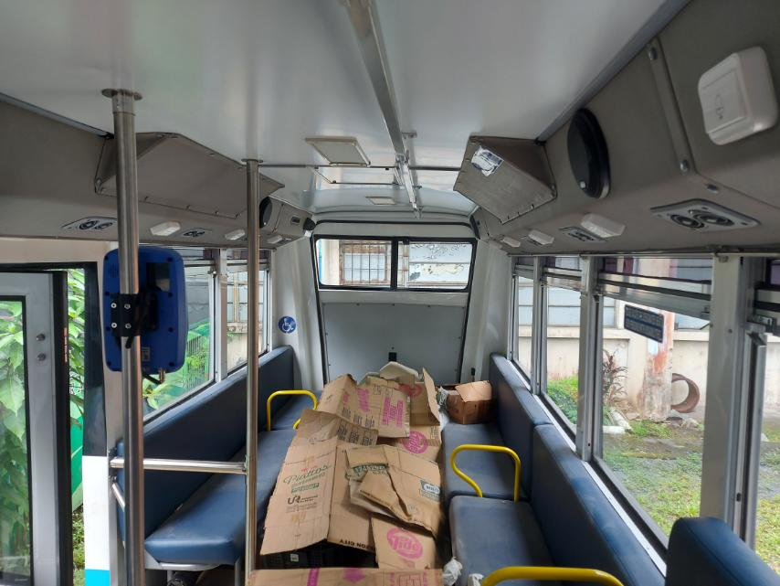
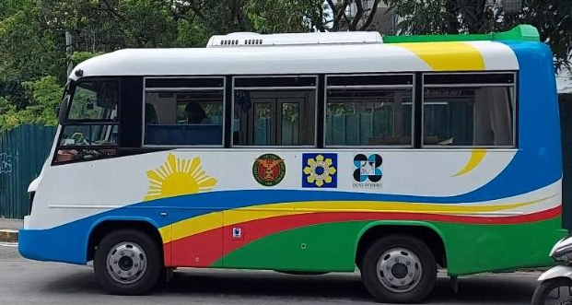
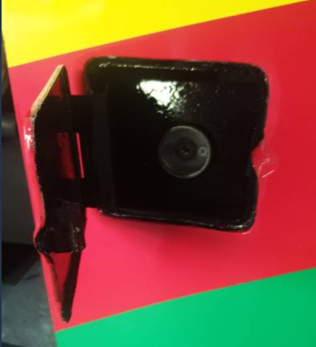
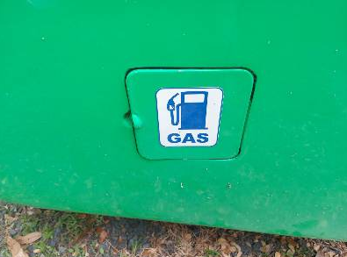
Overall Accomplishments ( Technical Details )
1. An 18-passenger Auto-LPG PUV built on an OEM vehicle platform compliant with PNS 2126:2017, PUV Class I ; Actually a bi-fuel PUV, runs on either LPG or gasoline.
LPG and Gasoline filling ports

Slide 11
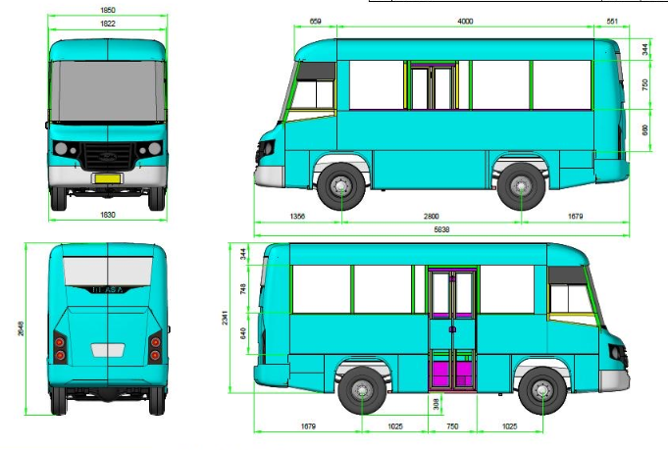
Overall Accomplishments ( Technical Details )
1. An 18-passenger Auto-LPG PUV built on an OEM vehicle platform compliant with PNS 2126:2017, PUV Class I ; Actually a bi-fuel PUV, runs on either LPG or gasoline.
Body dimensions: LxWxH, stepboard ground clearance, side and emergency doors, wheelbase, front & rear overhangs

Slide 12
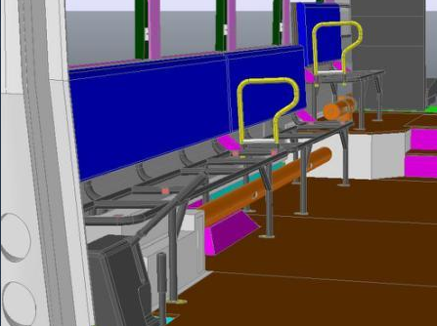
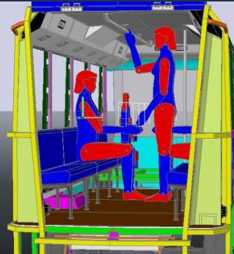
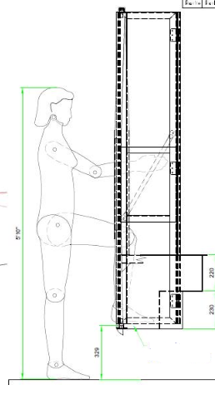
Overall Accomplishments ( Technical Details )
1. An 18-passenger Auto-LPG PUV built on an OEM vehicle platform compliant with PNS 2126:2017, PUV Class I ; Actually a bi-fuel PUV, runs on either LPG or gasoline.
Seated and standing clearances
Step board ground clearance
Seat and partition dimensions

Slide 13
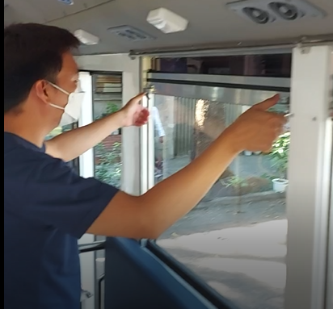
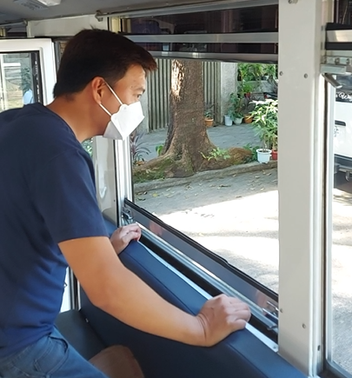
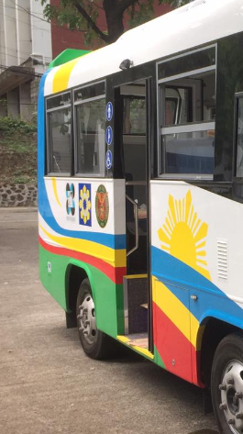
Overall Accomplishments ( Technical Details )
2. Vertically sliding window panes allowing full window opening to maximize natural ventilation and emergency exit area if necessary
Raising to fully closed, lowered to fully open window positions
Fully closed and partially open windows as seen from the outside

Slide 14
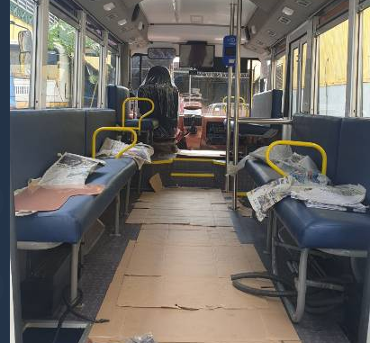
Overall Accomplishments ( Technical Details )
3. Partitions for long passenger seat to arrest passenger compression during sudden or hard breaking
Seat partitions to arrest passenger compression

Slide 15
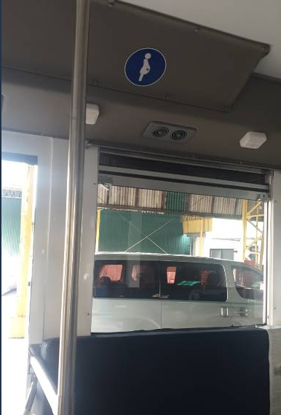
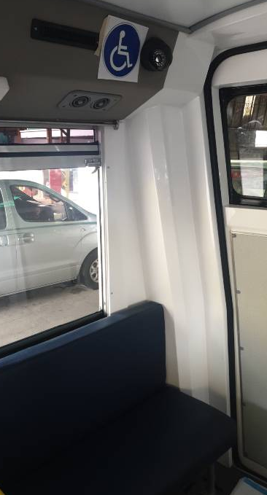
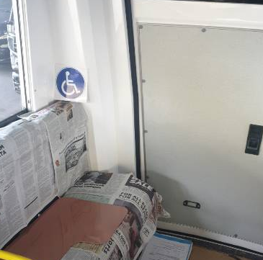
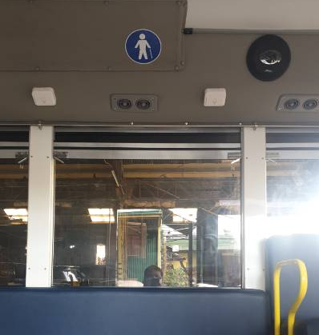
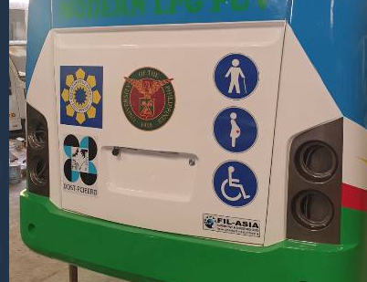
Overall Accomplishments ( Technical Details )
4. Marked seats for PWDs

Slide 16
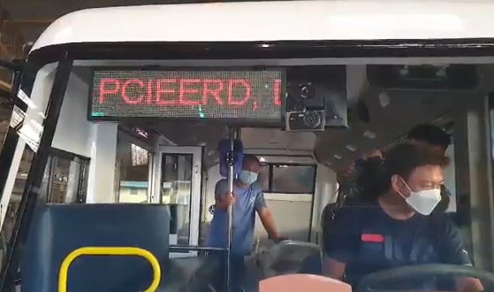
Overall Accomplishments ( Technical Details )
5. Digital Signage for Route/Travel info for passengers & PWDs

Slide 17
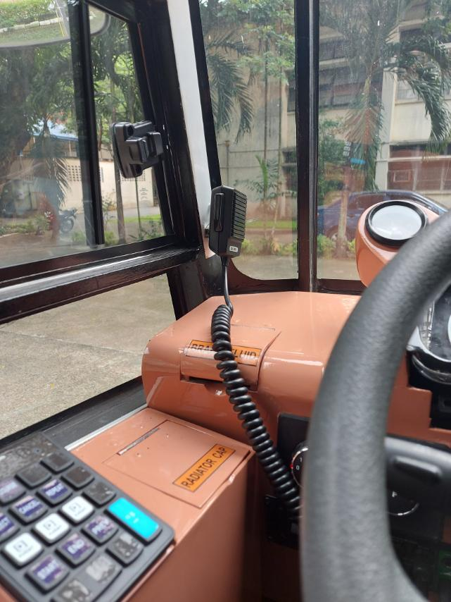
Overall Accomplishments ( Technical Details )
6. Public address system for Route/Travel info for passengers & PWDs
Microphone
Front & rear speakers

Slide 18
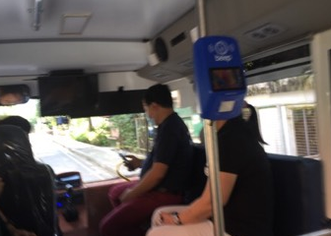
Overall Accomplishments ( Technical Details )
7. Electronic fare payment system

Slide 19
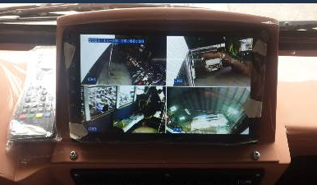
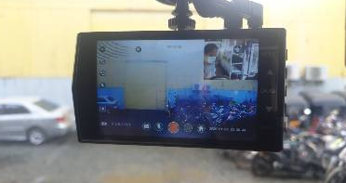
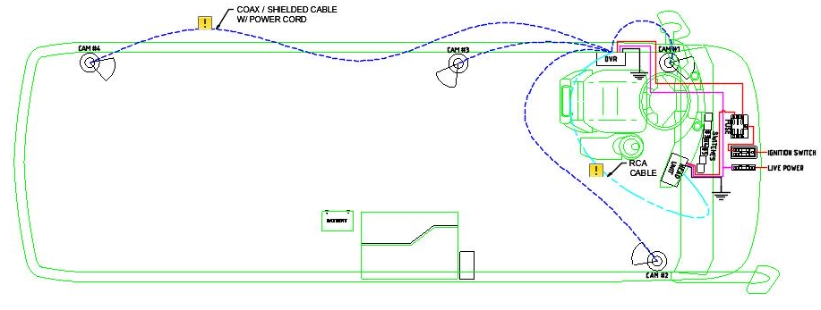
Overall Accomplishments ( Technical Details )
8. CCTV system for security and safety
Pics showing CCTV cameras and monitor displays

Slide 20
Overall Accomplishments ( Technical Details )
9. Distributed and easy access PUV Stop buttons

Slide 21
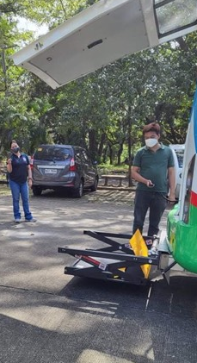
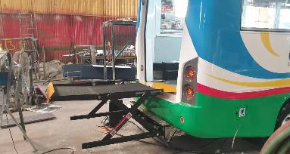
Overall Accomplishments ( Technical Details )
10. Wheelchair Lift System

Slide 22
Overall Accomplishments ( Technical Details )
Anti-Covid integrated design of AC air flow and distribution using CFD to minimize cross-flow of airborne particles among passengers;
⇒ Separate AC air return/exhaust system designed and installed
Adjusting AC air inlet opening and orientation to conform with CFD analysis
AC air return/exhaust pvc pipes under seats

Slide 23
Assumptions used for the CFD study
Full cabin capacity (1 driver + 18 passengers)
Volume flow follows the 12 air changes per hour requirement
Modified return ports for the air conditioning system with 5 ports per side of the vehicle (total of 10) under the seats of the passengers
Equal flow coming out of all inlet ports above the cabin occupants at 45° relative to the horizontal
Equal flow going into each return port.

Slide 24
With rear left exhaust fan NO Return/Exhaust Pipe
Driver Side Airflow (12 Air Changes/Hr)

Slide 25
With rear right exhaust fan NO Return/Exhaust Pipe
Door Side Airflow (12 Air Changes/Hr)

Slide 26
Return/exhaust pipes installed under seats
Driver Seat

Slide 27
Driver Side Airflow (12 Air Changes/Hr)
With rear left exhaust fan WITH Return/Exhaust Pipe

Slide 28
With rear right exhaust fan WITH Return/Exhaust Pipe
Door Side Airflow (12 Air Changes/Hr)

Slide 29
Overall Accomplishments ( Technical Details )
Anti-Covid integrated design of AC air flow and distribution using CFD to minimize cross-flow of airborne particles among passengers;
⇒ Separate AC air return/exhaust system designed and installed
Adjusting AC air inlet opening and orientation to conform with CFD analysis
AC air return/exhaust pvc pipes under seats

Slide 30
6Ps
3. PRODUCTS
A prototype PUV with 18-passenger capacity running on LPG or gasoline is built using an OEM vehicle platform
The PUV is PWD-Friendly, incorporates a wheelchair lift and marked seats
Has visual and audio announcement systems for the hearing- or visually-impaired
1. PUBLICATION
A technical paper is currently being written for publication; waiting for results of UP-Ikot road tests.
PATENTS
We will identify what can be patentable and then file for the appropriate patent.

Slide 31
6Ps
4. PEOPLE SERVICES
N.A.
5. POLICIES
Project Report will give recommendations on the technology approach for pursuing the use of LPG for PUVs.
6. PLACES & PARTNERSHIPS
N.A.

Slide 32
Plans after project completion
Help push for the use of LPG in PUVs as a transition measure while waiting for EV use to be feasible for mainstream public transport
Propose for actual deployment of LPG PUV prototype or similar units in the SM North – UP route to obtain both O&M technical and economic data
Identify/examine the appropriate business model to mainstream LPG use in public transport
Continue CFD analysis with experimental / actual verification of AC and ventilation systems of existing PUVs for immediate application to minimize Covid transmission.

Slide 33
Thank You

Slide 35
Project Objectives vs. Accomplishments
d) Road-test the prototype jeepney design
UP-Ikot Road Test Results are shown below.

Slide 36
PHASE 1 Route (SHORT roundtrip length of 13.25 km) Consists of urban driving segments (mostly 2-4 lanes per direction) characterized by stop-and-go conditions because of traffic signals and relatively shorter distances between stops
EASTBOUND Route (SM North to UP Vinzon’s Hall : 6.75 km)

Slide 37
PHASE 1 Route (SHORT roundtrip length of 13.25 km)
WESTBOUND Route (UP Vinzon’s Hall to SM North: 6.5 km)

Slide 38
Table 1 – Summary Data of Phase 1 Test Jeepneys
JEEPNEY | Pass. | Curb Wt. | Engine | Size | Power* | Torque*
 | # | (kg) | (Model) | (ltr.) | (kW @ rpm) | (Nm @ rpm)
2nd Diesel | 20 | 1,200 | Isuzu 4BC2 | 3.3 | 65 @ 3500 | 200 @ 2200
2nd LPG | 20 | 1,500 | Hyundai Theta | 2.0 | 107 @ 6000 | 190 @ 4000
3rd LPG | 22 | 2,280 | Toyota 4RB2 | 2.4 | 106 @ 5000 | 217 @ 4000
2nd Diesel Jeepney
2nd LPG Jeepney
3rd LPG Jeepney
GVW with 22+1 pax:
3,430 kg

Slide 39
Fuel Economy – On-Road
2nd LPG Jeepney
a – 2nd LPG jeepney ave. Load Factor = 59.81 %
b – 3rd LPG jeepney simulated on-road tests ave. Load Factor = 100 %
3rd LPG Jeepney
GVW with 22+1 pax:
3,430 kg

Slide 40
Fuel Economy - Laboratory
2nd LPG Jeepney
a – 2nd LPG jeepney
b – 3rd LPG jeepney
3rd LPG Jeepney
GVW with 22+1 pax:
3,430 kg

